Slide 1
Financials

Slide 2
Market Share

Slide 3
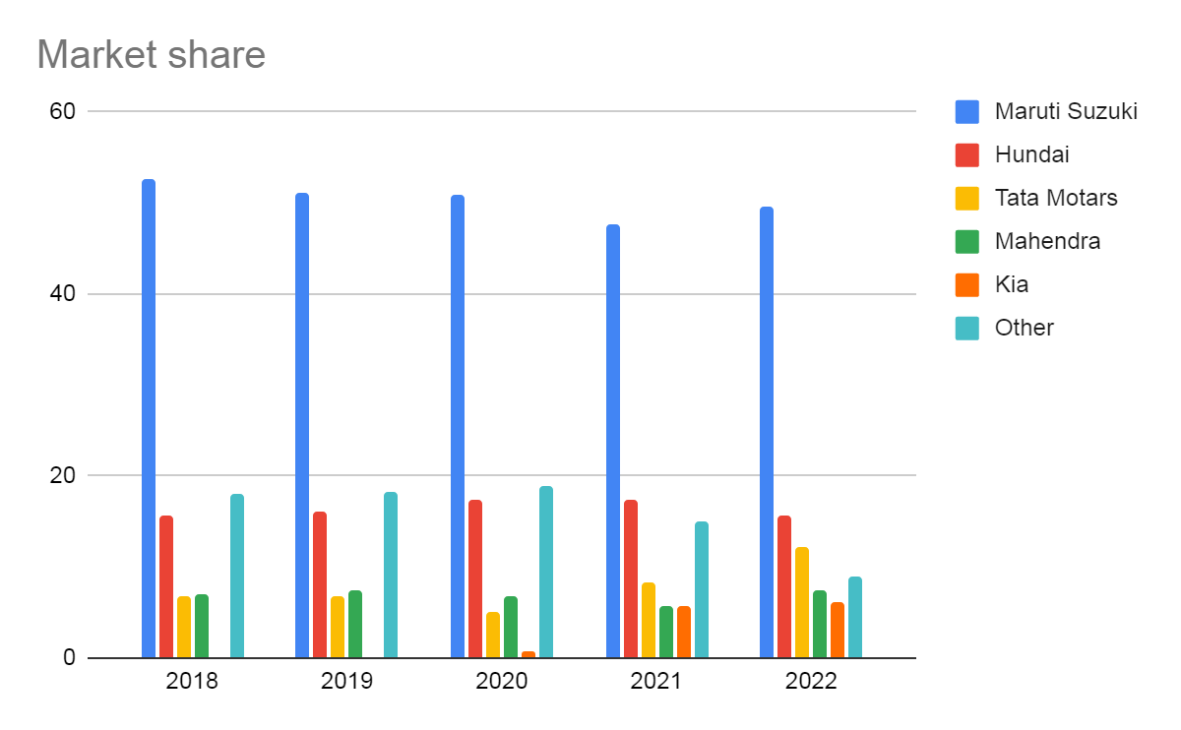
Market Share

Slide 4
Market Sales

Slide 5
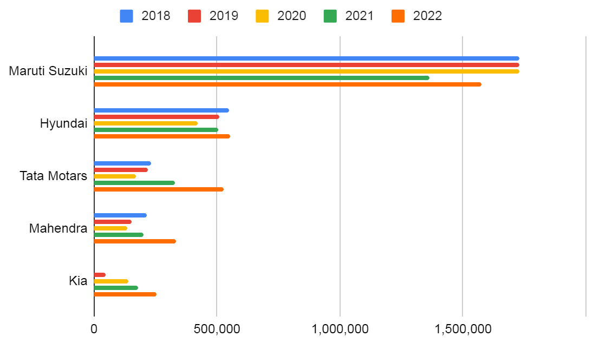

Slide 6
Net Profit

Slide 7
